Slide 1
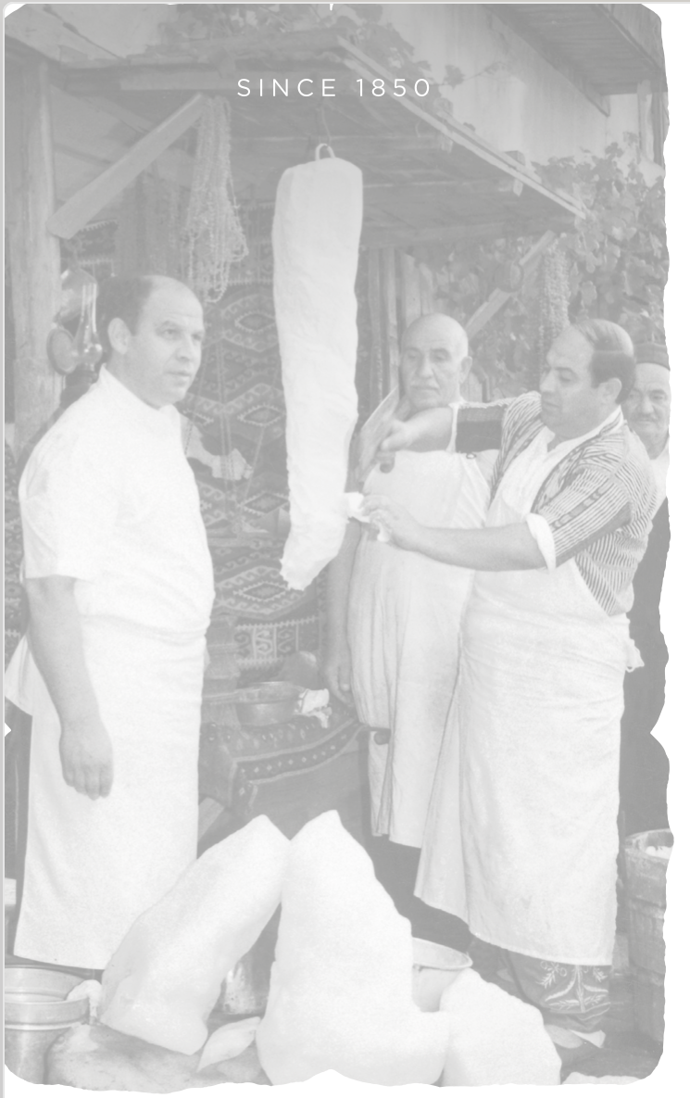

2025 PRICE LIST (March)

Slide 2
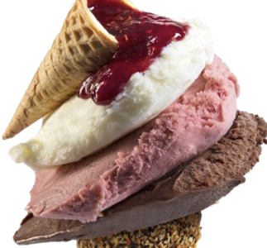
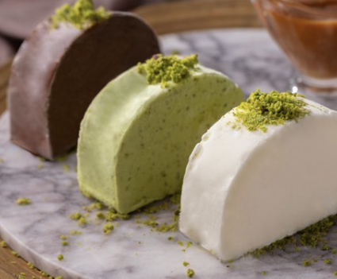
ICE CREAM

Slide 3

MARCO TRADE
MADO MARKET EXCLUSIVE DISTRIBUTOR
www.madoflorida.com
Description of Goods | Unit of Measure | KG Price | Single paket Price | Total Box Inside Package Units | Single Packet Weight | Price Per Box
PLAIN ICE CREAM 500g PACKAGE | KG | $14.90 | $7.45 | 9 pack | 500 g | $67.07
COCOA&PLAIN ICE CREAM 500g PACKAGE | KG | $15.89 | $7.95 | 9 pack | 500g | $71.54
COCOA&PISTACHIO&PLAIN ICE CREAM PACKAGE | KG | $15.89 | $7.95 | 9 pack | 500g | $71.54
PLAIN ICE CREAM 50g | KG | $17.39 | $0.87 | 60 pcs/3kg | 50 g | $52.16
PLAIN ICE CREAM 1000g | KG | $14.41 | $14.41 | 12 pack | 1 kg | $172.89
COCOA ICE CREAM 1000g | KG | $15.89 | $15.89 | 12 pack | 1 kg | $190.77
PISTACHIO ICE CREAM 1000g | KG | $20.99 | $20.99 | 12 pack | 1 kg | $251.87
PLAIN ICE CREAM "4 KG BULK" | KG | $15.89 | $57.63 | 2 Bulk | 4kg | $115.25
COCOA ICE CREAM "4 KG BULK" | KG | $15.89 | $63.60 | 2 Bulk | 4kg | $127.18
PISTACHIO ICE CREAM "4 KG BULK" | KG | $15.89 | $83.96 | 2 Bulk | 4kg | $167.92
CARAMEL ICE CREAM "4 KG BULK" | KG | $15.89 | $63.60 | 2 Bulk | 4kg | $127.18
MANGO ICE CREAM "4 KG BULK" | KG | $15.89 | $63.60 | 2 Bulk | 4kg | $127.18
PINEAPPLE ICE CREAM "4 KG BULK" | KG | $15.89 | $63.60 | 2 Bulk | 4kg | $127.18
CHIPS CHOCOLATE ICE CREAM "4 KG BULK" | KG | $15.89 | $63.60 | 2 Bulk | 4kg | $127.18
LEMON ICE CREAM "4 KG BULK" | KG | $15.89 | $63.60 | 2 Bulk | 4kg | $127.18
MIX FRUIT ICE CREAM "4 KG BULK" | KG | $15.89 | $63.60 | 2 Bulk | 4kg | $127.18
operations@madoflorida.com 251 Galen Dr # E216 KEY BISCAYNE FLORIDA 33149

Slide 4
MARCO TRADE
MADO MARKET EXCLUSIVE DISTRIBUTOR
www.madoflorida.com
Description of Goods | Unit of Measure | KG Price | Single paket Price | Total Box Inside Package Units | Single Packet Weight | Price Per Box
ORANGE ICE CREAM "4 KG BULK" | KG | $15.89 | $63.60 | 2 Bulk | 4kg | $127.18
BANANA ICE CREAM "4 KG BULK" | KG | $15.89 | $63.60 | 2 Bulk | 4kg | $127.18
MELON ICE CREAM"4 KG BULK" | KG | $15.89 | $63.60 | 2 Bulk | 4kg | $127.18
COCONUT ICE CREAM "4 KG BULK" | KG | $15.89 | $63.60 | 2 Bulk | 4kg | $127.18
HONEY ALMOND ICE CREAM"4 KG BULK" | KG | $17.26 | $69.06 | 2 Bulk | 4kg | $138.12
PLAIN ICE CREAM WITH CHOCOLATE SAUCE | KG | $33.53 | $65.40 | 2 Bulk | 1.95 kg | $130.78
PLAIN ICE CREAM WITH RASPBERRY SAUCE | KG | $33.53 | $65.40 | 2 Bulk | 1.95 kg | $130.78
BONBON ICE CREAM WITH CHOCOLATE SAUCE | KG | $19.87 | $39.74 | 1 Bulk | 2 kg | $39.74
MACARON ICE CREAM ''PINK'' | KG | $19.87 | $39.74 | 96pcs/4 Pack | 2,3 kg | $45.70
MACARON ICE CREAM ''YELLOW'' | KG | $19.87 | $39.74 | 96pcs/4 Pack | 2,3 kg | $45.70
MACARON ICE CREAM ''GREEN'' | KG | $19.87 | $39.74 | 96pcs/4 Pack | 2,3 kg | $45.70
LIGHT PLAIN OCE CREAM "4 KG BULK" | KG | $19.87 | $79.49 | 2 Bulk | 4kg | $158.98
VEGAN COCONUT ICE / SORBET "4 KG BULK" | KG | $17.39 | $69.55 | 2 Bulk | 4kg | $139.10
VEGAN BITTER CHOCOLATE ICE / SORBET "4 KG BULK" | KG | $17.39 | $69.55 | 2 Bulk | 4kg | $139.10
SOUR CHERRY ICE / SORBET "4 KG BULK" | KG | $15.89 | $63.60 | 2 Bulk | 4kg | $127.18
STRAWBERRY ICE / SORBET "4 KG BULK" | KG | $15.89 | $63.60 | 2 Bulk | 4kg | $127.18
operations@madoflorida.com 251 Galen Dr # E216 KEY BISCAYNE FLORIDA 33149

Slide 5
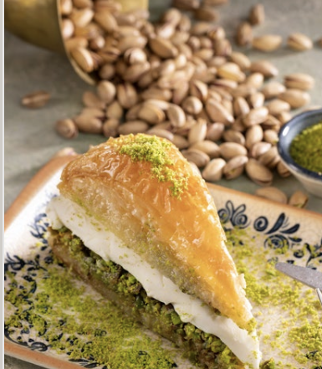
MARCO TRADE
MADO MARKET EXCLUSIVE DISTRIBUTOR
www.madoflorida.com
Description of Goods | Unit of Measure | KG Price | Single paket Price | Total Box Inside Package Units | Single Packet Weight | Price Per Box
BLACK MULBERRY ICE / SORBET"4 KG BULK" | KG | $20.24 | $80.98 | 2 Bulk | 4kg | $161.95
RASPBERRY ICE / SORBET"4 KG BULK" | KG | $20.24 | $80.98 | 2 Bulk | 4kg | $161.95
BLACKBERRY ICE / SORBET"4 KG BULK" | KG | $20.24 | $80.98 | 2 Bulk | 4kg | $161.95
operations@madoflorida.com 251 Galen Dr # E216 KEY BISCAYNE FLORIDA 33149

Slide 6
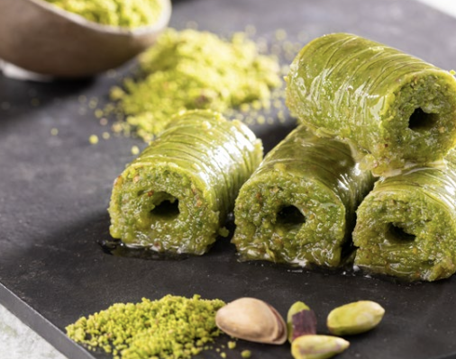
DESERTS

Slide 7
MARCO TRADE
MADO MARKET EXCLUSIVE DISTRIBUTOR
www.madoflorida.com
Description of Goods | Unit of Measure | KG Price | Single paket Price | Total Box Inside Package Units | Single Packet Weight | Price Per Box
BAKED AND FROZEN PISTACHIO BACLAVA | KG | $27.68 | $60.90 | 5 tray | 2.2 kg | $304.51
BAKED AND FROZEN PISTACHIO ROLL BACLAVA | KG | $37.54 | $82.58 | 5 tray | 2.1 kg | $394.13
BAKED AND FROZEN PISTACHIO SCHOBIET BACLAVA | KG | $33.32 | $66.63 | 5 tray | 2 kg | $333.13
BAKED AND FROZEN PISTACHIO CARROT SLICED BAKLAVA | KG | $33.32 | $26.65 | 5 tray | 0,8 kg | $133.25
BAKED AND FROZEN COLD BACLAVA | KG | $35.19 | $17.60 | 5 tray | 0,5 kg | $87.98
BAKED AND FROZEN PISTACHIO BACLAVA | KG | $27.68 | $34.59 | 5 tray | 1,25 kg | $173.03
BAKED AND FROZEN WALNUT BACLAVA | KG | $19.94 | $24.92 | 5 tray | 1,25 kg | $124.63
BAKED AND FROZEN MUSSEL SHAPED DESSERT WITH PISTACHIO | KG | $37.54 | $46.92 | 5 tray | 1,25 kg | $234.60
BAKED AND FROZEN PISTACHIO CARROT SLICED BAKLAVA | KG | $33.32 | $41.63 | 5 tray | 1,25 kg | $208.20
RAW AND FROZEN PISTACHIO&CHOCOLATE KADAYIF | PCS | $58.65 | $23.46 | 16 Pack | 6,4 kg | $375.36
BAKED AND FROZEN WALNUT BACLAVA | KG | $19.94 | $43.87 | 5 tray | 2,2 kg | $219.35
BAKED AND FROZEN PISTACHIO KADAYIF | KG | $28.15 | $49.27 | 5 tray | 1,75 kg | $246.33
operations@madoflorida.com 251 Galen Dr # E216 KEY BISCAYNE FLORIDA 33149

Slide 8
MARCO TRADE
MADO MARKET EXCLUSIVE DISTRIBUTOR
www.madoflorida.com
Description of Goods | Unit of Measure | KG Price | Single paket Price | Total Box Inside Package Units | Single Packet Weight | Price Per Box
BAKED AND FROZEN PISTACHIO DRY BACLAVA | KG | $27.68 | $60.90 | 5 tray | 2,2 kg | $304.51
RAW AND FROZEN TRADITIONAL KUNEFE WITH CHEESE (PORTION) | PCS | $32.02 | $4.81 | 20 Pcs | 150g | $96.05
RAW AND FROZEN TWIST PISTACHIO KADAYIF (PORTION) | PCS | $42.50 | $6.81 | 20 Pcs | 160g | $127.79
RAW AND FROZEN CREAM KADAYIF (PORTION) | PCS | $32.02 | $4.81 | 20 Pcs | 150g | $96.05
BAKED AND FROZEN HAMBURGER BACLAVA | PCS | $53.27 | $5.87 | 9 pcs | 110g | $52.79
TIRAMISU | PCS | $17.60 | $17.60 | 1 pcs | 950g | $17.60
FROZEN TRES LECHE CAKE | PCS | $16.42 | $28.73 | 4 tray | 1750g | $114.93
RAW AND FROZEN MOSAIC CAKE | PCS | $38.82 | $50.46 | 1 pcs | 1300g | $50.46
MILK JAM (UNIT) | PCS | 3.67 unit | $211.14 | 50 pcs | 40g | $211.14
FROZEN TURKISH DELIGHT WITH POMEGRANATE AND PISTACHIO | PCS | $50.58 | $17.71 | 12 pcs | 350g | $212.46
FROZEN HAZELNUT TURKISH DELIGHT | PCS | $45.15 | $9.03 | 30 pcs | 200g | $270.76
PISTACHIO TURKISH DELIGHT | PCS | $55.13 | $11.03 | 30 pcs | 200g | $330.79
PISTACHIO PASTE | KG | $41.63 | $83.35 | 4 pack | 2kg | $333.41
ALMOND PASTE | KG | $31.31 | $62.64 | 4 pack | 2kg | $250.55
operations@madoflorida.com 251 Galen Dr # E216 KEY BISCAYNE FLORIDA 33149

Slide 9
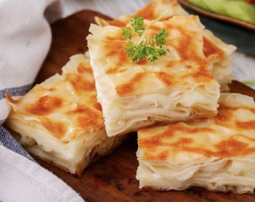
BAKERY

Slide 10
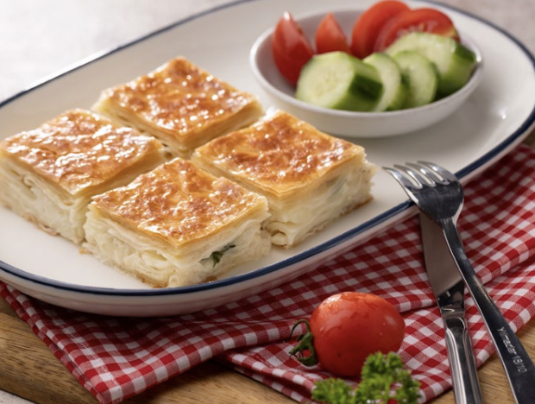
MARCO TRADE
MADO MARKET EXCLUSIVE DISTRIBUTOR
www.madoflorida.com
Description of Goods | Unit of Measure | KG Price | Single paket Price | Total Box Inside Package Units | Single Packet Weight | Price Per Box
BAKED AND FROZEN HOME STYLE 'PATTY | KG | $14.67 | $14.67 | 5 tray | 1 kg | $73.35
BAKED AND FROZEN HOME STYLE PATTY | KG | $19.71 | $4.92 | 6 pack | 1,5 kg | $29.56
RAW AND FROZEN PATTY WITH CHEESE | KG | $17.00 | $35.72 | 5 tray | 2,1 kg | $178.57
RAW AND FROZEN PATTY WITH CHEESE (PORTION) | PCS | $18.77 | $4.22 | 20 Pcs | 225g | $84.46
RAW AND FROZEN ''ACMA''BAGEL WITH CHEESE | PCS | $7.52 | $0.83 | 48 pcs | 110g | $39.74
RAW AND FROZEN PLAIN BAGEL WITH SUSAME | PCS | $7.52 | $0.83 | 40 pcs | 110g | $33.12
operations@madoflorida.com 251 Galen Dr #E216 KEY BISCAYNE FLORIDA 33149

